Slide 1
Introduction to online research literature

Slide 2
Overview
What is online research literature?
Why would I use it?
What is available here and now?
How do I find what I need?
How can I be sure it is reliable?

Slide 3
Definition “Online research literature”
Your ideas?
Any examples?
Notes:
Plenary discussion – ask for definition of online research literature (e-resources) and examples
May need to distinguish between resource and search engine

Slide 4
Definitions
An online resource is any information source that can only be accessed using a computer
May be electronic version of print
May be electronic version only
Notes:
Workshop will focus on library material – implying research value, peer reviewed
For simplicity, we’ll normally be referring to e-resources
Electronic format – online, DVD, CD, even just on local network
Could be Print version converted to electronic – digitisation projects
Electronic document which will also be printed
Electronic only – “born digital”

Slide 5
Scope
Electronic journals
Electronic books
Databases
Reference material
Digital collections
Other related materials
Notes:
The facilitator can expand on this to include other library material like newspapers, magazines, reports and the like
Various terms use – e-resource, electronic resource etc

Slide 6
Why use online resources?
Small group discussion (5 minutes)
List as many benefits as possible of online research literature / resources
What disadvantages can you identify?
Notes:
Allow 5 minutes for discussion

Slide 7
Benefits
Current
Easy and efficient retrieval process
Sharing of resources (can be accessed by many at the same time)
Easy to access related items
Easy to browse
Enhanced security (no loses, no mutilation...)
Notes:
Benefits to users
-explain fast procurement models (titles are added as soon as published)
Explain the ease in retrieving online information as opposed to print (in the latter items my be misshelved, misplaced, etc.)
One item can be accessed by many users at the same time
You can browse by author, subject or titles at a click of a button

Slide 8
Most important benefit
Enhances Research Activities
the benefits listed above enhance access to quality content which leads to more and better research output
Notes:
1.1. Introduction to e-resources management

Slide 9
Electronic resources available
Notes:
Purpose
To demonstrate the electronic resources and materials available to librarians and researchers in the country through the INASP Website. To highlight information which will help librarians in selecting which resource to use – Content overview, subject strengths. To demonstrate sections which help librarians in using and raising awareness of resources – service strengths, librarians sections on publisher webpages which may contain training or promotional materials.

Slide 10
What is available
Research4Life
INASP
Open access from publishers
Institutional repositories
Other access initiatives
Direct subscriptions

Slide 11
INASP country resource pages
http://www.inasp.info/[country]
See a list of all resources available to your country
INASP has negotiated free access to these resources
Url for access to resource
Description of content and service features
Need to register, ideally with fixed IP address
Notes:
Online demo if possible
See a list of all resources available to your country – paid (by consortium, free at point of use), negotiated free or Open Access
INASP will negotiate with some publishers to offer free access to certain INASP countries where libraries in the rest of the world pay a subscription

Slide 12
Open Access resources
http://www.inasp.info/en/training-resources/open-access-resources/
Multi-disciplinary resources
Subject specific resources
Open access readings
Directory of Open Access Journals
http://doaj.org/
Notes:
Open Access is often confused with Free resources (not necessarily peer reviewed). Ensure the participants understand that Open access is peer reviewed research output.

Slide 13
Research 4 Life
http://www.research4life.org/
HINARI
Access to Research in Health (12,700 journals, 24,900 books)
http://www.who.int/hinari/en/
AGORA
Access to Global Online Research in Agriculture (3,500 journals, 3,400 books)
http://www.aginternetwork.org/en/
OARE
Online Access to Research in the Environment (5,300 journals, 1,100 books)
http://www.oaresciences.org/training/en/index.html
ARDI
Access to Research for Development and Innovation (2,000 journals, 5,000 books)
http://www.wipo.int/ardi/en/
Notes:
Some countries are eligible for free access to R4L, others have to pay a minimal subscription.

Slide 14
Institutional repositories
http://www.inasp.info/en/training-resources/open-access-resources/institutional-repositories/
“online space for collecting, preserving, and disseminating, in digital form, the intellectual output of an institution”
http://www.opendoar.org/search.php

Slide 15
Other access initiatives
Oxford Journals
http://www.oxfordjournals.org/access_purchase/developing_countries.html
JSTOR
http://about.jstor.org/libraries/african-access-initiative
Notes:
Adapt as appropriate for each country – check http://www.research4life.org/institutions/ for R4L eligibility
Add a slide or move live to the consortium website if appropriate

Slide 16
Legal issues
Authorised users only
Employees, faculty, staff and students walk in users from not for profit organisations
Off campus use possible
Permitted use
Private use or research, no commercial use
15% of content of journal or book only
Prohibitions
No altering, copying, systematic downloading
Copyright
Remains with the publisher
Notes:
Legal issues raised in terms and conditions are commonly:
"Authorized Users", defined as: employees, faculty, staff and students who are officially affiliated with the Subscribing Institution's library facilities; Remote access by authorized users via the subscribing institution’s proxy server is permitted.; may also include users from the general public (walk in users) who are permitted by the Subscribing Institution to access the Resources from designated terminals within the Subscribing Institution's IP site. Passwords must not be provided to anyone outside the registered institution.
Permitted use - download, save, or print text, search results or other information solely for the private use or research of the Authorized Users.
Prohibitions
Altering, recompiling, systematic or programmatic copying, reselling, redistributing, publishing or re-publishing the resource content or any part thereof without explicit permission from the copyright holder is prohibited.
Systematic downloading, printing for profit-generating purposes and/or the systematic making of electronic copies for transmission to non-subscribers or non-subscribing institutions are prohibited.
Downloading of Resources or parts of Resources to form a persistent local archive is not allowed without the expressed written permission of the Publisher.
Withdrawal of Resources or Parts of Resources
The Publisher reserves the right to withdraw from this Agreement any of the Resources or any part of any of the Resources in order to comply with any legal rule or court order, or if the Publisher is at risk of liability from the continued availability of the Item or part of it.
Copyright
Copyright in the Publisher's Resources and their contents, including the abstracts, is vested in the Publisher, whose proprietary and publishing rights are protected under national and international law. Neither Authorized Users nor the Subscribing Institution shall have any proprietary right in any of the Resources by reason of their access to them.

Slide 17
Practical
Handout 1 - Using Online Resources.Docx contains links to various resources
Take some time now to look at what is available

Slide 18
General principles for effective searching of online resources
Notes:
On completion of this session participants will be able to:
Identify what one needs to know before searching
Determine the most likely sources of information
Identify an appropriate and effective search strategy
Evaluate different search strategies
Develop and improve search strategies

Slide 19
Outline
Search planning
Searching
Refining a search
Boolean operators
Truncation
Evaluating a search
Notes:
This module is about searching in general, initially focused on general Web searching but the technique and principles apply to what ever e-resource / environment one is searching, so these apply to library e-resources that are the focus of the rest of the workshop.
Learning objectives
Identify what you need to know before you start searching
Review the importance of knowing what you are searching
Identify an appropriate and effective search strategy
Evaluate different search strategies
Practise and use personally appropriate search strategies

Slide 20
What to you want?
Journal
Specific title
Article
Specific article
Any article on the subject
Information
Any reliable source

Slide 21
To find a specific journal
Is it in Research4Life?
Use the A-Z listing
Is it in Directory of Open Access Journals?
Search by title
Search on Google
Who is the publisher? Do you have access through other routes e.g. JSTOR, INASP?

Slide 22
To find a specific article
Find the journal title as previously
Use the journal platform (webpage) to browse or search for the article you want
Use search options to search under issue, date, author, article title etc
If you don’t have access to the journal, would a pre-print suffice?
Search OpenDOAR or institutional repository of one of the authors

Slide 23
To find any article or information
Develop a search strategy

Slide 24
Preparing a search strategy
Effective searching is a process
Define a search topic
Identify possible search terms
Refine a search strategy
Notes:
The purpose of thinking about your topic before you start searching is to determine what terms to search for and what features you need to search successfully.

Slide 25
Defining a search topic
Your search topic
Sexual violence in armed conflicts
What do you know about the topic?
Define the scope
Regional coverage (continent, region, country, etc.)
e.g. in Africa, in Kenya, in Western Kenya…
Notes:
-Example – Sexual violence in armed conflicts in Africa (or in Kenya or in Western Kenya)

Slide 26
Identifying Search Terms
What are the possible terms you can use for searching?
Examples
Sexual violence
Sexual harassment, sexual crime, sexual assault, sexual abuse, rape
Armed conflicts
Regional conflicts, war, armed forces, women in armed conflicts,
Notes:
Allow participants to add more related terms where possible

Slide 27
Identifying Search Terms
Issues to consider
Synonyms (mobile phones, cellular phones)
Plural/singular forms (woman, women…)
Spelling variations (honour, honor…)
Variations of root word (feminism, feminist, feminine….)
Acronyms (CEO, Chief Executive Office…)
Lower/upper case
Notes:
What UNIQUE WORDS, DISTINCTIVE NAMES, ABBREVIATIONS, or ACRONYMS are associated with your topic?
Do any of the words to describe your topic belong in phrases or strings - together in a certain order, like a cliché?
Can you think of synonyms, variant spellings, or equivalent terms you would also accept in relevant documents?
Can you think of any extraneous or irrelevant documents these words might pick up?
What BROADER terms could your topic be covered by?

Slide 28
Where to start the search
GoogleScholar or other search engine
Research 4 Life website
INASP country page or Open Access pages
Publisher website
Library website
Other logical starting point e.g. professional institute webpage
Notes:
Need to be able to identify the right place to search
Can you think of societies, organizations, or groups that might have information on your subject via their pages?

Slide 29
Searching
Any of the identified terms and related terms can be used in the search separately
The end results will be overwhelming making selection fairly time consuming
To enhance accuracy and save on time, one has to refine the search by combining search terms
Notes:
Just plunging in could bring up too many results, so need to develop means to refine your search

Slide 30
Predicting results
How many documents would you like to retrieve?
A few very specific ones?
Lots of general ones?
Notes:
Sometimes the best result is just a single answer to a question so just a few results which answer this are OK – Checking of a fact - Is the UN assisting in preventing sexual violence in Kenya?
Sometimes you want a few specific articles - commissioned research on how the response to sexual violence in Kenya compares with Sierra Leone
Sometimes you want a lot of general articles – a student preparing an assignment for a politics course

Slide 31
Refining a search
Using the identified search terms separately is a broad search which may result in overwhelming results
To refine the search one has to narrow the search
Boolean Operators assist a researcher to combine two or more search terms to enhance accuracy

Slide 32
Phrase searching
If you want to search for a phrase, put it in parentheses
E.g. “Digestive diseases”
If you do not do so, most systems treat separate words as if OR operator was present

Slide 33
Broad or specific terms
Broad terms may yield more results, which may be more general
E.g. Digestive diseases
Specific (narrow) terms may yield fewer results which may be more relevant
E.g. irritable bowel syndrome; peptic ulcers

Slide 34
Boolean operators
Boolean Operators consists of 3 words
AND
OR
NOT
These words can be used to combine search terms to narrow or broaden the search

Slide 35
Boolean operators
AND: retrieves a document on condition that both search terms used are present
e.g. Sexual violence AND armed conflicts
OR: retrieves documents with either of the search terms used
e.g. sexual violence OR armed conflicts
flu OR influenza
NOT: Excludes documents with one of the search terms from the results
Sexual violence NOT rape
Notes:
Test participants to ensure they have grasped the meaning of the 3 terms.
Which of the above produces most documents? (or)
Which produces least? (and)
Which one carries a risk of losing useful documents?
Facilitator might like to have some more examples if the participants are confused by this.

Slide 36
Truncation
Truncation is another strategy for broadening a search
It helps to retrieve related terms in one search
It also solves the problem of singular and plural
Truncation is used with a code e.g. $ or *
This depends on the search engine used
Notes:
- Computers are machines and cannot reason. A search using plural e.g. Economics will not retrieve documents with singular e.g. economic development

Slide 37
Truncation
EXAMPLES
Search Topic is Economics and development
Economic development will certainly be useful to this topic
Econ*. Will retrieve documents with both terms
Notes:
NB Very few unrelated terms start “econ” so also use another example to ensure that participants have grasped the difference
Need to be careful where you truncate – where would be best place to truncate a search for librarianship and library science? What would happen if you truncate too early?

Slide 38
Field searching
Most publisher resources offer advanced search functions
Author
Journal title
Article title
Date ranges
Abstract
Notes:
You can specify if your chosen search term should appear in any field
For example “Farmer” can be a surname so if you want articles by someone called “Farmer” you could get a lot of irrelevant items if you can’t specify that it is a name

Slide 39
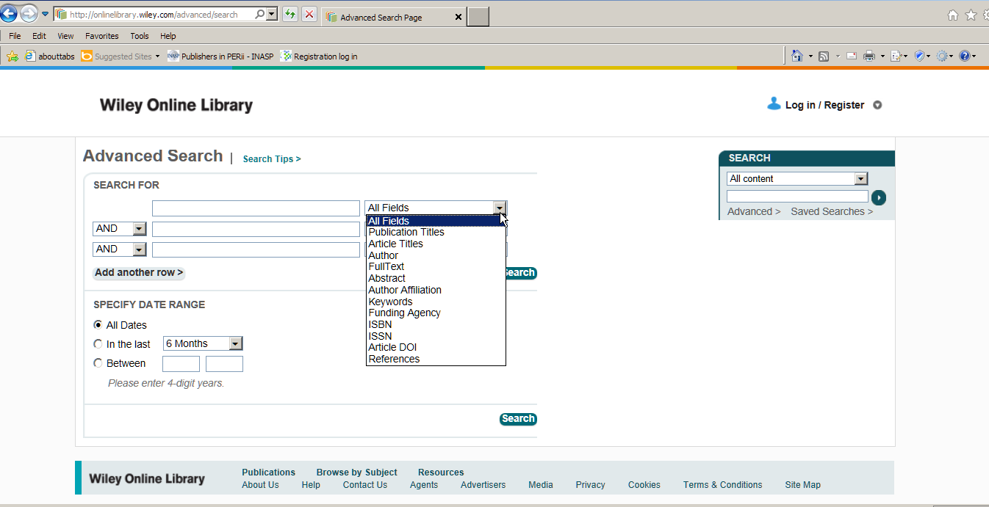
Notes:
Wiley advanced search fields (representative of many resources)
DOI = Digital Object Identifier
A CrossRef DOI is an alphanumeric name that identifies digital content, such as a book or journal article. The DOI is paired with the object's electronic address, or URL, in an updateable central directory, and is published in place of the URL in order to avoid broken links while allowing the content to move as needed. - See more at: http://www.crossref.org/03libraries/index.html#sthash.giW5theV.dpuf

Slide 40
Search modifications
What alternative spellings are there for learner-centred?
Where should we truncate pedagogical?
What will searching education produce?
Would you get any irrelevant items if you searched train the trainer? How would you use this search string?
Notes:
Ask participants for suggestions
Learner-centred – American spelling, with or without hyphen
Ped* would get pedal etc
Education – huge number of results from most sources
Train the trainer – locomotives or shoes? Need inverted commas

Slide 41
Evaluating a search strategy
Too many results?
Review strategy
Use more specific terms
Combine search terms using AND or NOT
Too few results?
Review strategy
Use broader terms
Combine search terms using OR
Satisfied?
Download documents

Slide 42
Practical
Handout 1 - Using Online Resources.Docx contains some suggestions for searching
Work through those to find articles of interest to you

Slide 43
E-resource evaluation tips
Notes:
Purpose: to enable participants to examine a website to determine the credibility of the contents

Slide 44
Factors
What can the url tell you?
Scan the page
Quality indicators
What do others say?
What is your opinion?
Notes:
Details on next slides

Slide 45
What can the url tell you?
Is it somebody’s personal page?
Look for a personal name in the url
Is the server a commercial ISP providing web page hosting e.g. blogspot?
What type of domain is it?
.gov; .edu etc
Check country code
Is it a publishing entity that makes sense?
Notes:
Identify if resource is provided by a commercial publisher or a host anyone can sign up to
Personal pages are not necessarily "bad," but you need to investigate the author carefully. For personal pages, there is no publisher or domain owner vouching for the information in the page.

Slide 46
Scan the perimeter of the page
Who wrote the page?
Is it dated and sufficiently current?
What are the author’s credentials?
Notes:
Look for copyright information, usually at the end of the page
Look for links that say "About us," "Philosophy," "Background," "Biography", etc.

Slide 47
Look for indicators of quality
Are sources documented with links or footnotes?
Is reproduced information complete, not altered?
Is permission acknowledged?
Are there links to other resources on the topic?
How recent is the copyright date?
Notes:
Review some sample documents on the resource – spelling mistakes are a give away on the quality and a small sample is usually representative of the whole resource

Slide 48
What do others say?
Paste url into Alexa.com
Will give subjective reviews, traffic etc
Who links to the page?
Is the page listed in reliable directories?
E.g. http://www.ipl.org/
What do others say about the author?
Google the name of the author
Notes:
Alexa.com on next slide = Analytics for any Website
IPL = Internet Public Library (quite slow)

Slide 49
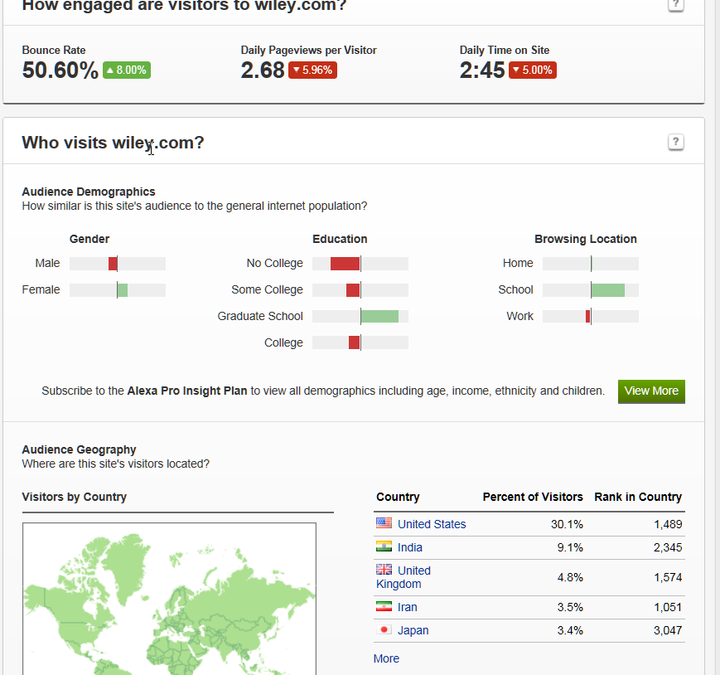
Notes:
Alexa.com review of Wiley
People are spending a relatively long time on the site (2.45 minutes is long!); site is used by more graduates than average internet sites, and more use it from “school” (=university) than average internet sites.

Slide 50
What is your own opinion?
Why was the page put on the web?
Does it feel trustworthy?
Is this as good as I would find if I used a library resource?
Notes:
Use your own feelings to judge if a site is current and reliable

Slide 51
Summary and reflection
There is much peer reviewed, reliable research literature available
Some resources require authentication by password or IP recognition
Use of online literature carries ethical obligations
Searching is a skill which can be developed
While most online information is reliable, it is always best to evaluate it

Slide 52
Thank you Any questions?
Thank you Any questions?
This work is licensed under a Creative Commons Attribution-ShareAlike 3.0 Unported License.
Notes:
You are free:
to Share — to copy, distribute and transmit the work
to Remix — to adapt the work
to make commercial use of the work
Under the following conditions:
Attribution — You must attribute the work in the manner specified by the author or licensor (but not in any way that suggests that they endorse you or your use of the work).
Share Alike — If you alter, transform, or build upon this work, you may distribute the resulting work only under the same or similar license to this one.
http://creativecommons.org/licenses/by-sa/3.0/

